Slide 1

Machine Learning and Data Mining
Lecture 5.1: Soft-Margin Support Vector Machines and Kernels

Slide 2
Administrative: Midterm Next Monday
Mix of multiple-choice / true-false / and written response.
Concept quizzes are good examples of some of the basic concept questions
Written response will sometimes include computation. Mostly deal with the operation of algorithms we’ve covered:
kNN, logistic regression, naïve bayes, SVM

Slide 3
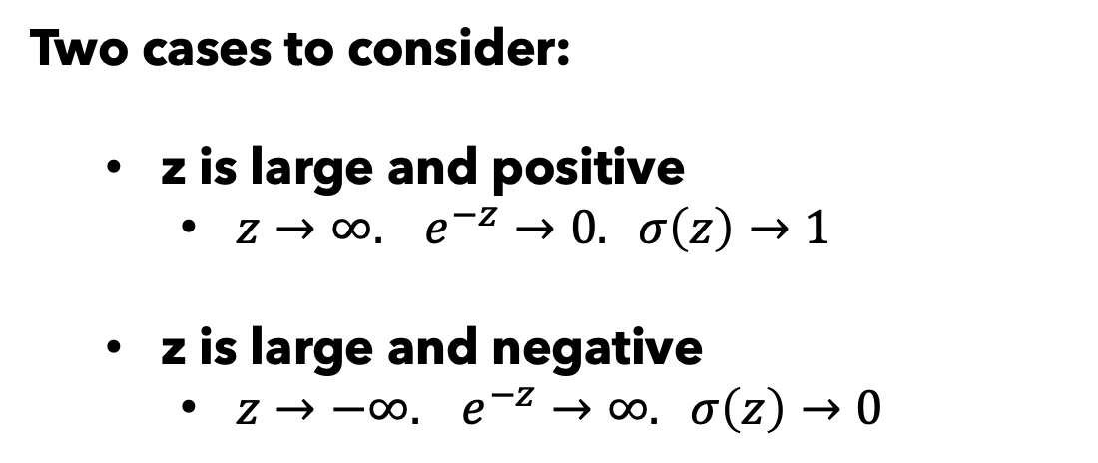
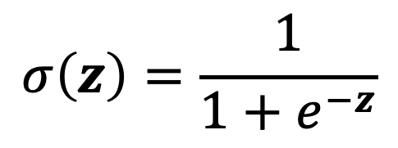
Numerical Stability
Consider computing the logistic:
$$σ\left(z\right)=\frac{1}{1+e^{−z}}$$
Two cases to consider:
z is large and positive
$z→∞. e^{−z}→0. σ\left(z\right)→1$
z is large and negative
$z→−∞. e^{−z}→∞. σ\left(z\right)→0$

Slide 4
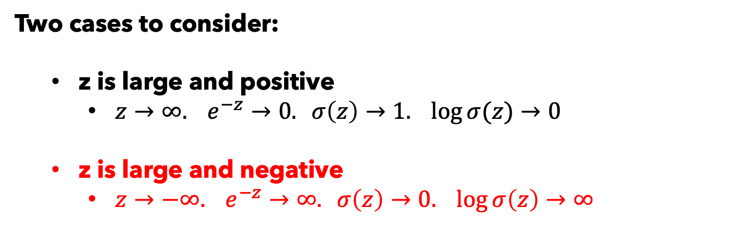
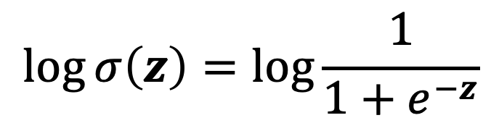
Numerical Stability
This time, consider computing the log-logistic:
$$\log{σ\left(z\right)}=\log{\frac{1}{1+e^{−z}}}$$
Two cases to consider:
z is large and positive
$z→∞. e^{−z}→0. σ\left(z\right)→1. \log{σ(z)}→0$
z is large and negative
$z→−∞. e^{−z}→∞. σ\left(z\right)→0. \log{σ\left(z\right)}→∞$

Slide 5
Numerical Stability

Slide 6
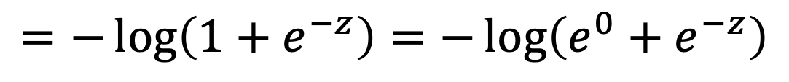
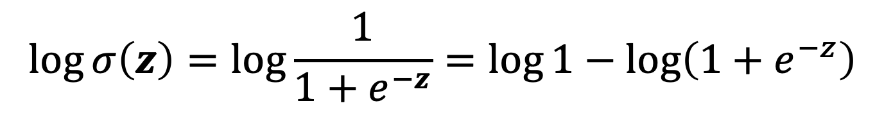
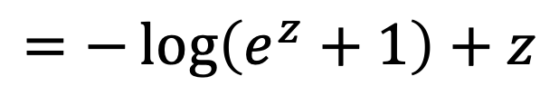
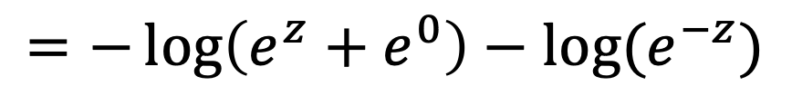
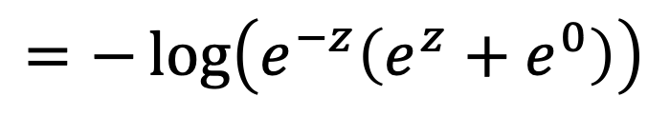
Numerical Stability
This time, consider computing the log-logistic:
$$\log{σ\left(z\right)}=\log{\frac{1}{1+e^{−z}}}=\log{1}−\log\left(1+e^{−z}\right)$$
$$=−\log\left(1+e^{−z}\right)=−\log\left(e^{0}+e^{−z}\right)$$
$$=−\log\left(e^{−z}\left(e^{z}+e^{0}\right)\right)$$
$$=−\log\left(e^{z}+e^{0}\right)−\log{(e^{−z})}$$
$$=−\log\left(e^{z}+1\right)+z$$

Slide 7
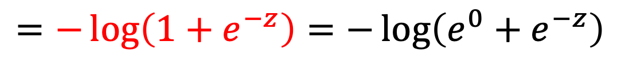
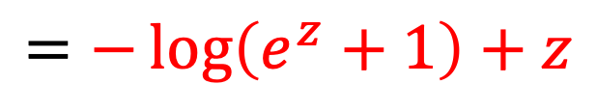
Numerical Stability
This time, consider computing the log-logistic:
$$\log{σ\left(z\right)}=\log{\frac{1}{1+e^{−z}}}=\log{1}−\log\left(1+e^{−z}\right)$$
(A)
$$=−\log\left(1+e^{−z}\right)=−\log\left(e^{0}+e^{−z}\right)$$
$$=−\log\left(e^{−z}\left(e^{z}+e^{0}\right)\right)$$
$$=−\log\left(e^{z}+e^{0}\right)−\log{(e^{−z})}$$
(B)
$$=−\log\left(e^{z}+1\right)+z$$

Slide 8
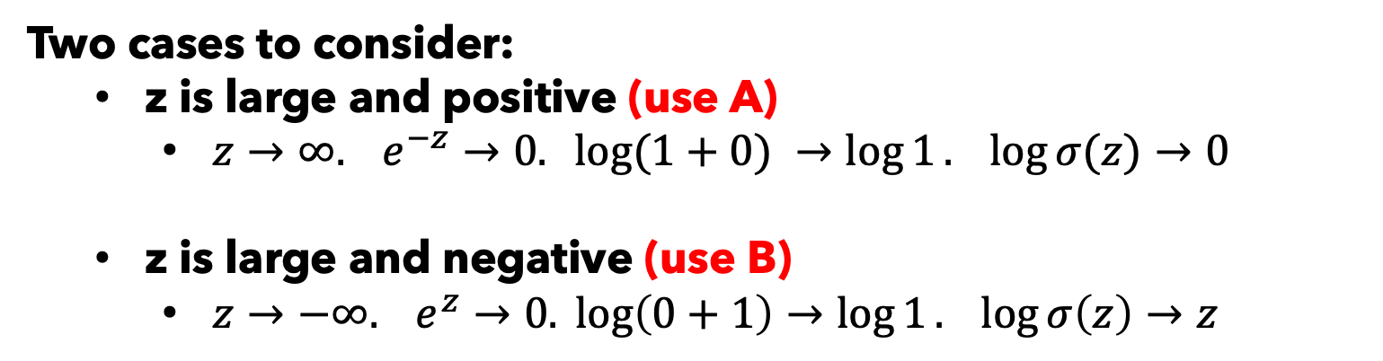
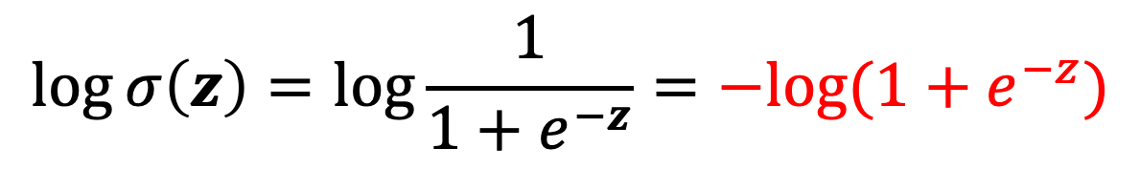
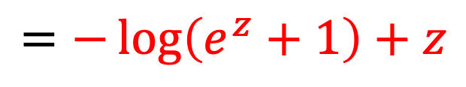
Numerical Stability
This time, consider computing the log-logistic:
$$\log{σ\left(z\right)}=\log{\frac{1}{1+e^{−z}}}=−log⁡(1+e^{−z})$$
(A)
$$=−\log\left(e^{z}+1\right)+z$$
(B)
Two cases to consider:
z is large and positive (use A)
$z→∞. e^{−z}→0. log⁡(1+0) →\log{1}. \log{σ(z)}→0$
z is large and negative (use B)
$z→−∞. e^{z}→0. \log\left(0+1\right)→\log{1}. \log{σ\left(z\right)}→z$

Slide 9
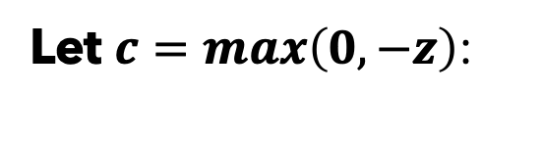
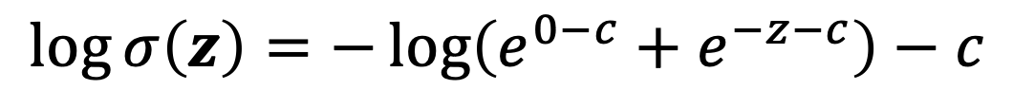
Numerical Stability
This time, consider computing the log-logistic:
$$\log{σ\left(z\right)}=\log{\frac{1}{1+e^{−z}}}=−log⁡(1+e^{−z})$$
(A)
$$=−\log\left(e^{z}+1\right)+z$$
(B)
Let $c=max\left(0, −z\right)$:
$$\log{σ\left(z\right)}=−\log\left(e^{0−c}+e^{−z−c}\right)−c$$
$$\log{σ\left(z\right)}=−\log\left(e^{0−0}+e^{−z−0}\right)−0=−log⁡(1+e^{−z})$$
(A when z > 0)
$$\log{σ\left(z\right)}=−\log\left(e^{0+z}+e^{−z+z}\right)+z=−\log\left(e^{z}+1\right)+z$$
(B when z < 0)

Slide 10
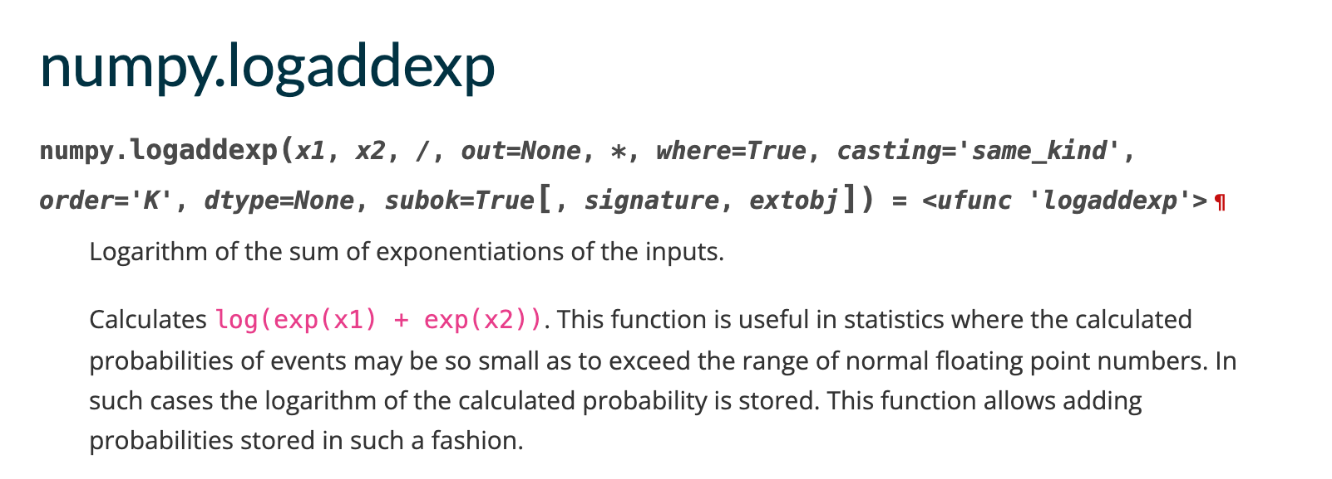
Numerical Stability
Numpy (and other packages) know this is a common problem:
Works the same way under the hood.

Slide 11
Numerical Stability
Let’s look at this in a colab:
https://colab.research.google.com/drive/17egtw1j2MkmWKIU52Y62dIW0pqYBIAhR?usp=sharing

Slide 12
HW2 Graphs with Stable NNL Calc
Step size = 1

Slide 13
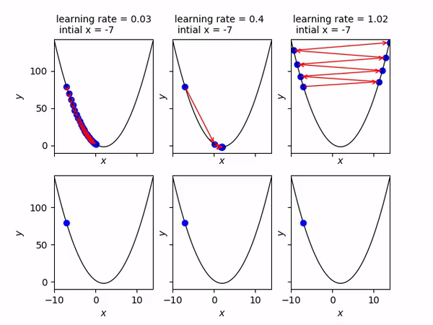
HW2 Graphs with Stable NNL Calc

Slide 15
A Motivating Discussion

Slide 16

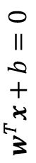
A Motivating Discussion
$$w^{T}x+b=0$$
$$w$$

Slide 17
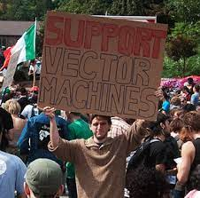
New Topic: Support Vector Machines
Algorithm Name: Support Vector Machines (SVM)
Type: Supervised Linear Classifier
Key Idea: Find the linear decision boundary that maximizes the margin between positive and negative examples.
What is a support vector? We’ll need to run through a lot of somewhat unintuitive math to really understand the structure of this problem. But the result will give us tremendous insight into this problem … and it’ll build character.

Slide 18

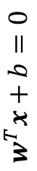
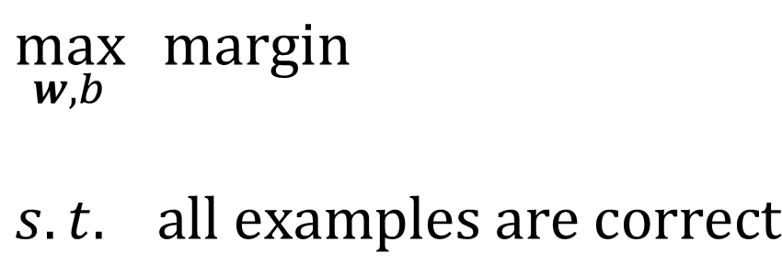
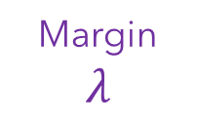
Hard-Margin SVM
Intuition for Hard-Margin SVM:
We want to find a classifier that separates the classes while maximizing the margin between positive and negative examples.
Assumes linear separability.
$$w^{T}x+b=0$$
$$w$$
$$\max_{w,b}{ margin}$$
$$s.t. all examples are correct$$
Margin
$$λ$$

Slide 19

Max-Margin Classifiers
Our goal for today:
We want to find a classifier that separates the classes while maximizing the margin between positive and negative examples. For now, we’ll assume linear separability and fix that later.
$$w^{T}x+b=0$$
$$w$$
Our plan of attack:
Set up some convenient notation
Derive an expression for our intuition
Set up a constrained optimization problem
Solve it to arrive at a Support Vector Machine
(some new math tools to analyze this– Lagrange multipliers)
Margin
$$λ$$

Slide 20
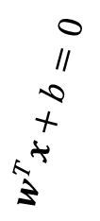
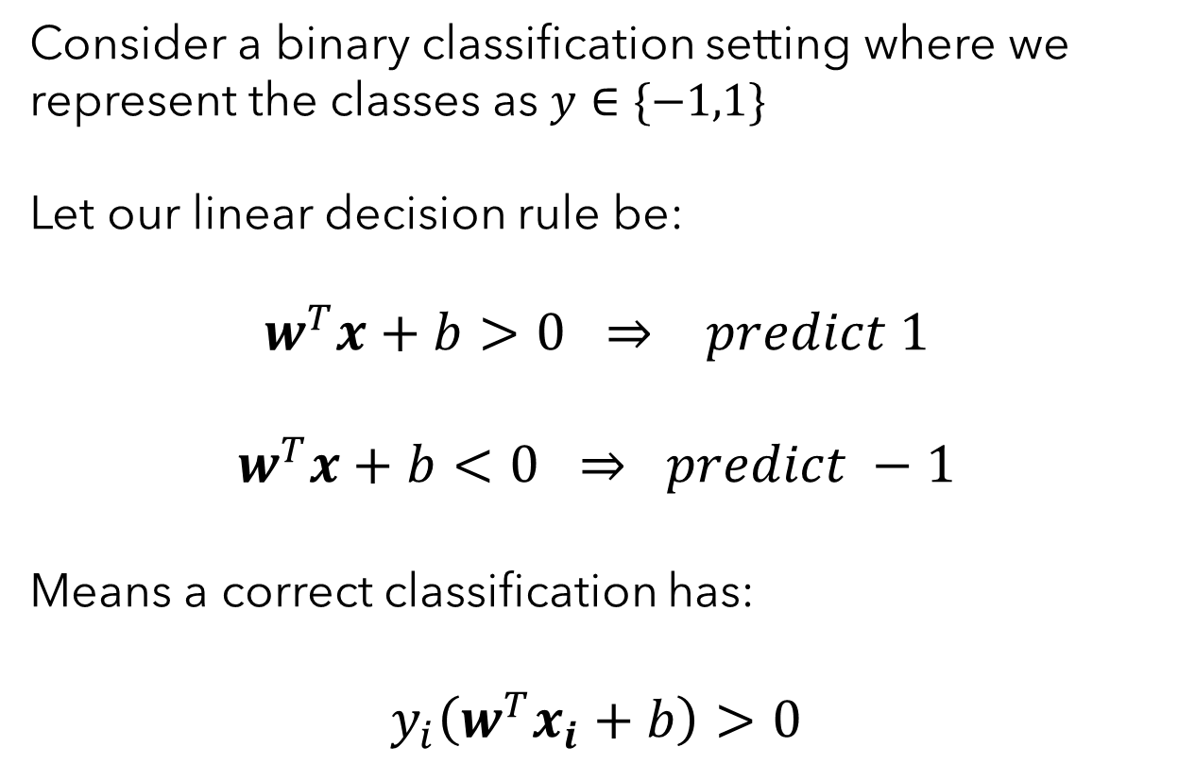
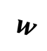
Step 1) Establish Some Convenient Notation
Problem Setup and Decision Rule
Consider a binary classification setting where we represent the classes as $y∈\{−1,1\}$
Let our linear decision rule be:
$$w^{T}x+b>0 ⇒ predict 1$$
$$w^{T}x+b<0 ⇒ predict −1$$
Means a correct classification has:
$$y_{i}\left(w^{T}x_{i}+b\right)>0$$
$$w^{T}x+b=0$$
$$w$$

Slide 21
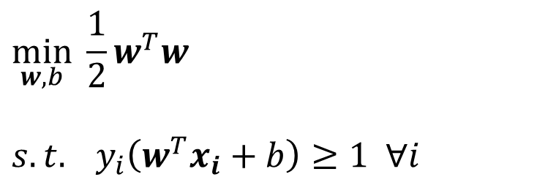
Hard-Margin Support Vector Machine Objective
How do we actually solve this? And by “solve” I mean optimal find w and b
$$\min_{w,b}{ \frac{1}{2}w^{T}w}$$
$$s.t. y_{i}\left(w^{T}x_{i}+b\right)≥1 ∀i$$
This is a quadratic function with linear constraints. Many (non-trivial) algorithms to solve these sorts of things – called Quadratic Program Solvers (QP-Solvers).

Slide 22

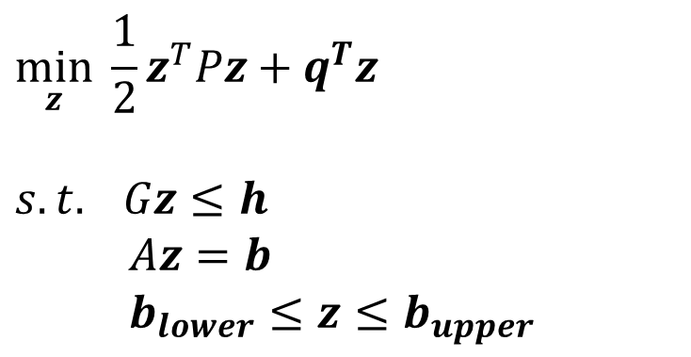
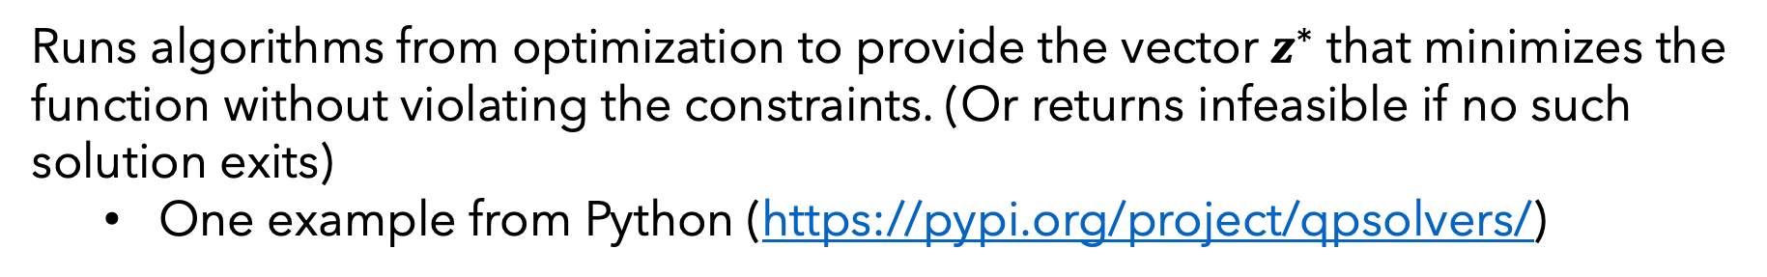
Hard-Margin Support Vector Machine Objective
What is a Quadratic Program Solver? Given equations of the form:
Quadratic equation in matrix notation
$$\min_{z}{ \frac{1}{2}z^{T}Pz+q^{T}z}$$
$$s.t. Gz≤h \\ Az=b \\ b_{lower}≤z≤b_{upper}$$
Linear inequality constraints
Linear equality constraints
Limits on the values of x
Runs algorithms from optimization to provide the vector $z^{∗}$ that minimizes the function without violating the constraints. (Or returns infeasible if no such solution exits)
One example from Python (https://pypi.org/project/qpsolvers/)

Slide 23
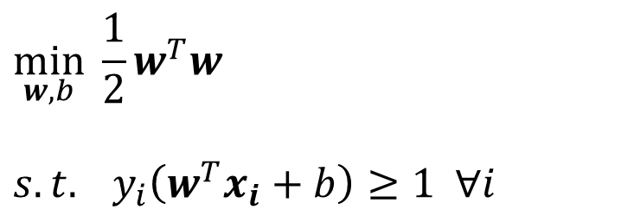

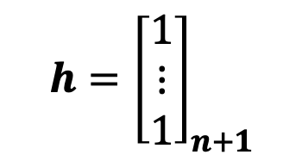
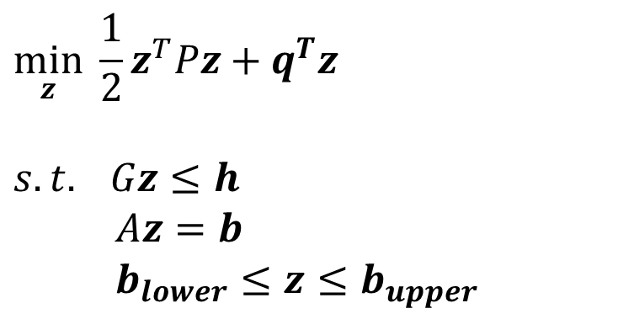
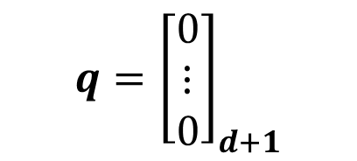

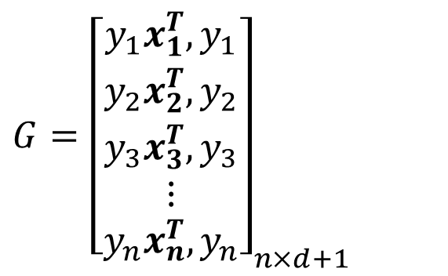
Hard-Margin Support Vector Machine Objective
How can we put this into a quadratic form?
$$\min_{z}{ \frac{1}{2}z^{T}Pz+q^{T}z}$$
$$s.t. Gz≤h \\ Az=b \\ b_{lower}≤z≤b_{upper}$$
$$\min_{w,b}{ \frac{1}{2}w^{T}w}$$
$$s.t. y_{i}\left(w^{T}x_{i}+b\right)≥1 ∀i$$
$$q={\left[\begin{aligned}0 \\ ⋮ \\ 0\end{aligned}\right]}_{d+1}$$
$G={\left[\begin{aligned}y_{1}x_{1}^{T},y_{1} \\ y_{2}x_{2}^{T},y_{2} \\ y_{3}x_{3}^{T},y_{3} \\ ⋮ \\ y_{n}x_{n}^{T},y_{n}\end{aligned}\right]}_{n×d+1 }$
$$z={\left[\begin{aligned}w \\ b\end{aligned}\right]}_{(d+1)×1}$$
$$P={\left[\begin{aligned}I_{d} \\ 0\end{aligned}\begin{matrix}0 \\ 0\end{matrix}\right]}_{d+1×d+1}$$
$$h={\left[\begin{aligned}1 \\ ⋮ \\ 1\end{aligned}\right]}_{n+1}$$

Slide 24
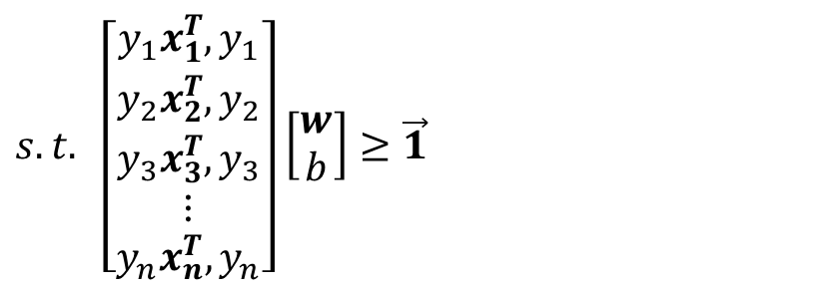
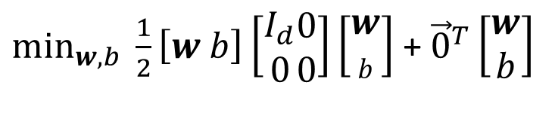
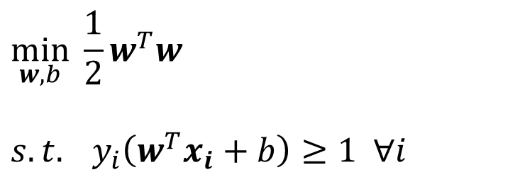
Hard-Margin Support Vector Machine Objective
How can we put this into a quadratic form?
$\min_{w,b}{ \frac{1}{2}\left[w b\right]\left[\begin{aligned}I_{d} \\ 0\end{aligned}\begin{matrix}0 \\ 0\end{matrix}\right]\left[\begin{aligned}w \\ b\end{aligned}\right]}$ + ${\vec{0}}^{T}\left[\begin{aligned}w \\ b\end{aligned}\right]$
$$\min_{w,b}{ \frac{1}{2}w^{T}w}$$
$$s.t. y_{i}\left(w^{T}x_{i}+b\right)≥1 ∀i$$
$s.t. \left[\begin{aligned}y_{1}x_{1}^{T},y_{1} \\ y_{2}x_{2}^{T},y_{2} \\ y_{3}x_{3}^{T},y_{3} \\ ⋮ \\ y_{n}x_{n}^{T},y_{n}\end{aligned}\right]$ $\left[\begin{aligned}w \\ b\end{aligned}\right]≥\vec{1}$
Can pass this to a QP solver and let some optimization people deal with it.
For our purposes however, there is some deeper bit of understanding to be gained from pushing this further with another method – Lagrange multipliers.

Slide 25
Demo SVM QP Manually Solved
https://colab.research.google.com/drive/1LTpGaj0ALwIrzq84yho6mpXTi9I4pwGN?usp=sharing

Slide 26
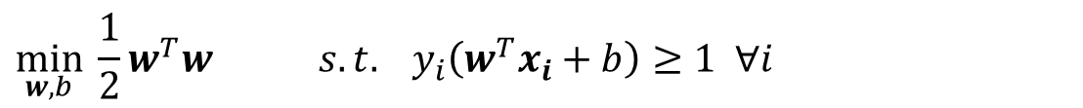
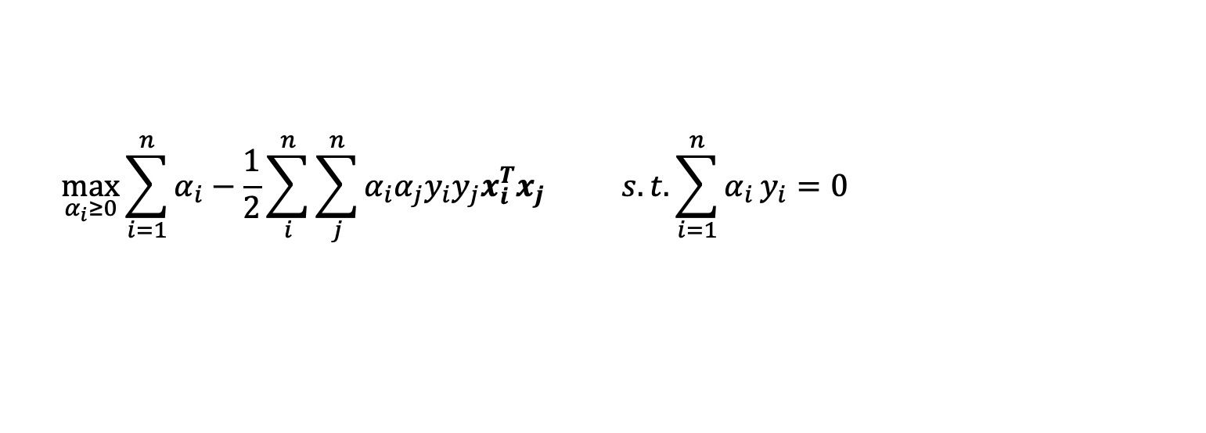
Hard-Margin SVM Primal and Dual Formulations
Hard-Margin SVM Primal:
$$\min_{w,b}{ \frac{1}{2}w^{T}w} s.t. y_{i}\left(w^{T}x_{i}+b\right)≥1 ∀i$$
Find best weights and bias directly
Hard-Margin SVM Dual:
$$\max_{α_{i}≥0}{\sum_{i=1}^{n}{α_{i}}−\frac{1}{2}\sum_{i}^{n}{\sum_{j}^{n}{α_{i}α_{j}y_{i}y_{j}x_{i}^{T}x_{j}}}} s.t. {\sum_{i=1}^{n}{α_{i}}y}_{i}=0$$
Find these optimization variables alpha, then derive best weights and bias

Slide 27
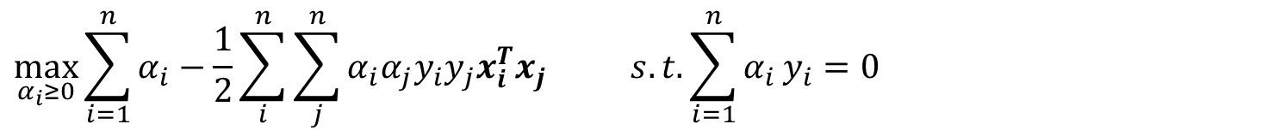
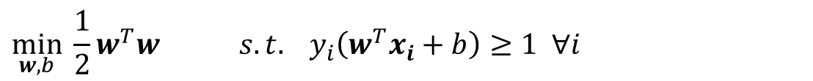
Recap of what we’ve been doing so far
Motivation: We wanted to find a classifier that maximizes the margin between classes.
Derivation: We derived the following constrained optimization problem that does that:
Hard-Margin SVM Primal:
$$\min_{w,b}{ \frac{1}{2}w^{T}w} s.t. y_{i}\left(w^{T}x_{i}+b\right)≥1 ∀i$$
We said that is a Quadratic Programming problem and totally solvable. Then I ran us through a lot of math to arrive at the dual formalization below which solves the same problem (KKT’s hold).
Hard-Margin SVM Dual:
$$\max_{α_{i}≥0}{\sum_{i=1}^{n}{α_{i}}−\frac{1}{2}\sum_{i}^{n}{\sum_{j}^{n}{α_{i}α_{j}y_{i}y_{j}x_{i}^{T}x_{j}}}} s.t. {\sum_{i=1}^{n}{α_{i}}y}_{i}=0$$
Which is also a Quadratic Programming problem (in $α$’s this time rather than w) and is totally solvable to global optimality….. …. so why did I do this to us all?

Slide 28

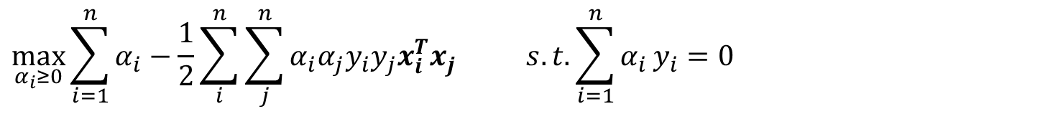
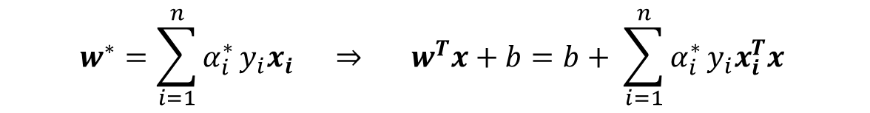
Examining the Dual Let Us Observe A Few Neat Things
Hard-Margin SVM Dual:
$$\max_{α_{i}≥0}{\sum_{i=1}^{n}{α_{i}}−\frac{1}{2}\sum_{i}^{n}{\sum_{j}^{n}{α_{i}α_{j}y_{i}y_{j}x_{i}^{T}x_{j}}}} s.t. {\sum_{i=1}^{n}{α_{i}}y}_{i}=0$$
Observation 1: The optimal weight vector is a linear combination of only a few of our training examples.
$$w^{∗}={\sum_{i=1}^{n}{α_{i}^{∗}}y}_{i}x_{i}$$
Observation 2: Both the objective and classifying new examples are just based on dot-products between input vectors.
$$w^{∗}={\sum_{i=1}^{n}{α_{i}^{∗}}y}_{i}x_{i} ⇒ w^{T}x+b=b+ {\sum_{i=1}^{n}{α_{i}^{∗}}y}_{i}x_{i}^{T}x$$

Slide 29
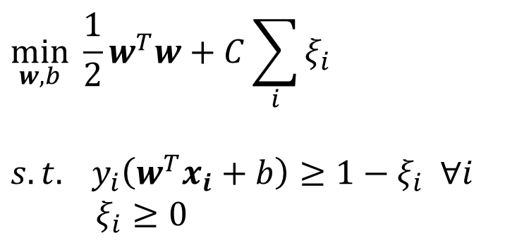
Teaser for Next Time: What about the non-linearly separable case?
Teaser 1: We can modify our objective function to try to maximize margin while making as few mistakes as possible. Will need to introduce some notion of the tradeoff between the two.
Maximize margin
Minimize violations of the margin
$$\min_{w,b}{ \frac{1}{2}w^{T}w}+C\sum_{i}{ξ_{i}}$$
$$s.t. y_{i}\left(w^{T}x_{i}+b\right)≥1−ξ_{i} ∀i \\ ξ_{i}≥0$$
Allow some violations
We’ll talk about how this works out next time.

Slide 30

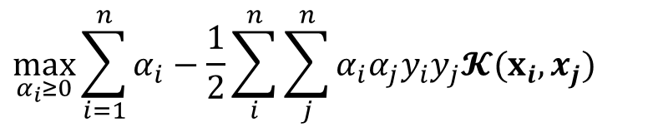
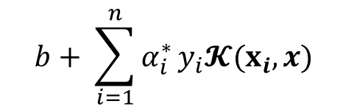

Teaser for Next Time: What about the non-linearly separable case?
Teaser 2: Apply the non-linear basis function idea again and just replace each point with some $Φ\left(x\right)$ that is non-linear. Then fit a linear classifier in that higher-dimensional space.
Train and find $w^{∗}={\sum_{i=1}^{n}{α_{i}^{∗}}y}_{i}Φ{(x}_{i})$
$$b+ {\sum_{i=1}^{n}{α_{i}^{∗}}y}_{i}Φ{\left(x_{i}\right)}^{T}Φ(x)$$
Predict based on $w^{T}Φ(x)+b$
This is expensive and we have to deal with those higher dimensions. What if we just defined a kernel that compute non-linear similarity without actually representing these high dimensional vectors.
SVMs operate on dot products between examples. Can “pretend” we are in a higher dimension – call this the kernel trick. More next time.
$$b+ {\sum_{i=1}^{n}{α_{i}^{∗}}y}_{i}𝓚(x_{i},x)$$
$$\max_{α_{i}≥0}{\sum_{i=1}^{n}{α_{i}}−\frac{1}{2}\sum_{i}^{n}{\sum_{j}^{n}{α_{i}α_{j}y_{i}y_{j}𝓚(x_{i},x_{j})}}}$$

Slide 31
Be able to answer:
How can we handle non-linearly separable data with a soft-margin Support Vector Machine?
What is the interpretation of a support vector now?
How can we implement one of these things with a QP solver?
What is the kernel trick and why is it useful?
What is the definition of a kernel?
What is a kernel SVM?
What else can we kernelize?
How do you kernelize perceptron?
How do you kernelize linear regression?

Slide 32
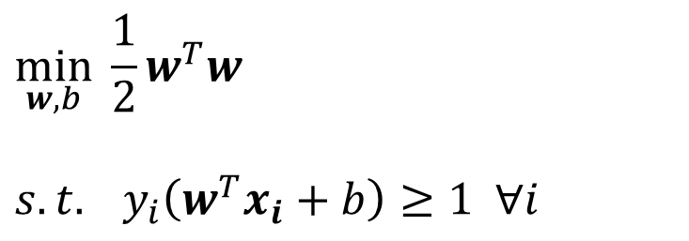
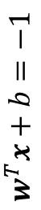
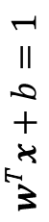
Soft-Margin Support Vector Machine
Hard-Margin SVMs assume the data is linearly separable – the optimization below has no solution for the case shown on the left:
$$w^{T}x+b=1$$
$$w^{T}x+b=0$$
$$w^{T}x+b=−1$$
$$\min_{w,b}{ \frac{1}{2}w^{T}w}$$
$$s.t. y_{i}\left(w^{T}x_{i}+b\right)≥1 ∀i$$
Hard-Margin SVM Primal:
$$w$$
Our goal for today: Adjust this optimization to enable some misclassifications. Will derive the Soft-Margin SVM.

Slide 33

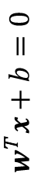


Soft-Margin Support Vector Machine
Idea: Maximize the margin while minimizing errors. Will balance these two opposing goals.
Very large margin. Many errors.
Very small margin. Few errors.
$$w^{T}x+b=1$$
$$w^{T}x+b=0$$
$$w^{T}x+b=−1$$
$$w$$

Slide 34





Soft-Margin Support Vector Machine
We already know how to maximize the margin. How can we express minimizing errors?
Last time, we had constraints that kept things out of the margin
$$w^{T}x+b=0$$
$$w^{T}x+b=1$$
$$w^{T}x+b=−1$$
$$y_{i}\left(w^{T}x_{i}+b\right)≥1 ∀i$$
$$w$$
Let’s allow each example to violate this by up to some value:
$$y_{i}\left(w^{T}x_{i}+b\right)≥1−ξ_{i} ∀i$$
So now each example i has some error tolerance $ξ_{i}≥0$. We refer to these as slack variables.

Slide 35










Soft-Margin Support Vector Machine
Let’s get a feeling for the slack variables.
$$w^{T}=\left[0,−2\right], \\ b=1$$
$$x_{i}^{T}=\left[1,2\right],$$
$$y_{i}=1$$
$$w^{T}x+b=0$$
$$w^{T}x+b=1$$
$$w^{T}x+b=−1$$
$$w^{T}x_{i}+b=−3$$
$$w^{T}x_{i}+b=−3$$
$$w$$
$$y_{i}\left(w^{T}x_{i}+b\right)=−3$$
$$x_{i}$$
If we want the constraint below to hold:
$$y_{i}\left(w^{T}x_{i}+b\right)≥1−ξ_{i} ∀i$$
Then the slack variable $ξ_{i}$ needs to be $≥4$

Slide 36

Soft-Margin Support Vector Machine
We can combine this “soft error” constraint with our previous optimization. This results in the
soft-margin SVM primal objective.
Maximize margin
Minimize violations of the margin
$$\min_{w,b}{ \frac{1}{2}w^{T}w}+C\sum_{i}{ξ_{i}}$$
$$s.t. y_{i}\left(w^{T}x_{i}+b\right)≥1−ξ_{i} ∀i \\ ξ_{i}≥0$$
Soft-Margin SVM Primal:
Allow some violations
Call the hyperparameter C the slack penalty. Let’s do some questions to see if this formulation passes the sniff test.

Slide 37

What happens as if the slack penalty C goes to zero?
The soft-margin SVM reverts to the hard-margin SVM formulation.
The margin gets infinitely big.
Errors aren’t penalized.
Errors are very heavily penalized.

Slide 38
What happens as if the slack penalty C goes to infinity?
The soft-margin SVM reverts to the hard-margin SVM formulation.
The margin gets infinitely big.
Errors aren’t penalized.
Errors are very heavily penalized.

Slide 39
How do we pick the value of the slack penalty C?
Just go with your first guess.
Whatever value of C works best on the test data
Cross-validation or evaluation on held-out validation data
Tune it until performance on training data gets good enough.

Slide 40

Soft-Margin Support Vector Machine – Dual Formulation
Just like the hard-margin case, we can derive the Lagrangian dual formulation. I’ll spare you the bloody details this time and just write it below:
Soft-Margin SVM Dual:
$$\max_{α_{i}}{\sum_{i=1}^{n}{α_{i}}−\frac{1}{2}\sum_{i}^{n}{\sum_{j}^{n}{α_{i}α_{j}y_{i}y_{j}x_{i}^{T}x_{j}}}}$$
$$s.t. {\sum_{i=1}^{n}{α_{i}}y}_{i}=0$$
$$0≤α_{i}≤C ∀i$$
Has a very, very similar form to the hard-margin dual except the addition of an upper bound on $α$’s. Can still be solved by passing it to a Quadratic Programming solver.

Slide 41

Soft-Margin Support Vector Machine – Dual Formulation
Just like the hard-margin case, this derivation leads us to the optimal weights being:
$$w^{∗}={\sum_{i=1}^{n}{α_{i}^{∗}}y}_{i}x_{i}$$
And from the KKT conditions we know only a sparse set of training examples have non-zero $α:$
$$α_{i}^{∗}\left(y_{i}\left({w^{∗}}^{T}x_{i}+b\right)−1+ξ_{i}\right)=0, ∀i$$
← Complementary slackness
Only training points within (or on the edge of) the margin are support vectors and effect the solution.

Slide 42






Comparing Hard and Soft Margin SVM
Hard-Margin SVM
Soft-Margin SVM
Hard-Margin SVM Primal:
$$\min_{w,b}{ \frac{1}{2}w^{T}w}$$
$$s.t. y_{i}\left(w^{T}x_{i}+b\right)≥1 ∀i$$
Soft-Margin SVM Primal:
$$\min_{w,b}{ \frac{1}{2}w^{T}w}+C\sum_{i}{ξ_{i}}$$
$$s.t. y_{i}\left(w^{T}x_{i}+b\right)≥1−ξ_{i} ∀i \\ ξ_{i}≥0$$
Hard-Margin SVM Dual:
$$\max_{α_{i}}{\sum_{i=1}^{n}{α_{i}}−\frac{1}{2}\sum_{i}^{n}{\sum_{j}^{n}{α_{i}α_{j}y_{i}y_{j}x_{i}^{T}x_{j}}}}$$
$$s.t. {\sum_{i=1}^{n}{α_{i}}y}_{i}=0$$
$$0≤α_{i} ∀i$$
Soft-Margin SVM Dual:
$$\max_{α_{i}}{\sum_{i=1}^{n}{α_{i}}−\frac{1}{2}\sum_{i}^{n}{\sum_{j}^{n}{α_{i}α_{j}y_{i}y_{j}x_{i}^{T}x_{j}}}}$$
$$s.t. {\sum_{i=1}^{n}{α_{i}}y}_{i}=0$$
$$0≤α_{i}≤C ∀i$$
Given optimal alphas – weight vector is:
Given optimal alphas – weight vector is:
$$w^{∗}={\sum_{i=1}^{n}{α_{i}^{∗}}y}_{i}x_{i}$$
$$w^{∗}={\sum_{i=1}^{n}{α_{i}^{∗}}y}_{i}x_{i}$$

Slide 43



A Note About Solving this Equation
Let $α=\left[\begin{aligned}α_{1} \\ α_{2} \\ ⋮ \\ α_{n}\end{aligned}\right]$
To plug this into a quadratic program solver, we need to get it into a canonical form
$$\max_{α_{i}}{\sum_{i=1}^{n}{α_{i}}−\frac{1}{2}\sum_{i}^{n}{\sum_{j}^{n}{α_{i}α_{j}y_{i}y_{j}x_{i}^{T}x_{j}}}}$$
$$s.t. {\sum_{i=1}^{n}{α_{i}}y}_{i}=0$$
$$0≤α_{i}≤C ∀i$$
?
$$\underset{α}{minimize}{ \frac{1}{ 2}α^{T}Pα+q^{T}α}$$
$$subject to Aα=h$$
$$b_{l}≤α≤b_{u} ∀i$$
where $P, q, A, h, b_{l}, and b_{u}$ define a quadratic program with linear equality constraints.

Slide 44

A Note About Solving this Equation
Let $α=\left[\begin{aligned}α_{1} \\ α_{2} \\ ⋮ \\ α_{n}\end{aligned}\right]$
To plug this into a quadratic program solver, we need to get it into a canonical form
$$\max_{α_{i}}{\sum_{i=1}^{n}{α_{i}}−\frac{1}{2}\sum_{i}^{n}{\sum_{j}^{n}{α_{i}α_{j}y_{i}y_{j}x_{i}^{T}x_{j}}}}$$
$$s.t. {\sum_{i=1}^{n}{α_{i}}y}_{i}=0$$
$$0≤α_{i}≤C ∀i$$
$$\underset{α}{minimize}{ \frac{1}{ 2}α^{T}\left[\begin{matrix}y_{1}y_{1}x_{1}^{T}x_{1} & … & y_{1}y_{n}x_{1}^{T}x_{n} \\ ⋮ & ⋱ & ⋮ \\ y_{n}y_{1}x_{n}^{T}x_{1} & … & y_{n}y_{n}x_{n}^{T}x_{n}\end{matrix}\right]α−{\vec{1}}^{T}α}$$
$$subject to {\left[\begin{aligned}y_{1} \\ ⋮ \\ y_{n}\end{aligned}\right]}^{T}α=0$$
$$\vec{0}≤α≤\vec{1}C ∀i$$
?

Slide 45

A Note About Solving this Equation
I’ve implemented this and passed it to a QP solver to make my own SVM implementation in the Colab notebook below. Let’s walk through this a bit.
$$\underset{α}{minimize}{ \frac{1}{ 2}α^{T}\left[\begin{matrix}y_{1}y_{1}x_{1}^{T}x_{1} & … & y_{1}y_{n}x_{1}^{T}x_{n} \\ ⋮ & ⋱ & ⋮ \\ y_{n}y_{1}x_{n}^{T}x_{1} & … & y_{n}y_{n}x_{n}^{T}x_{n}\end{matrix}\right]α−{\vec{1}}^{T}α}$$
$$subject to {\left[\begin{aligned}y_{1} \\ ⋮ \\ y_{n}\end{aligned}\right]}^{T}α=0$$
$$\vec{0}≤α≤\vec{1}C ∀i$$
https://colab.research.google.com/drive/1MznKB-UxlvIkYtG_vBon1Qg_jKx-sb3o?usp=sharing

Slide 46
Summarizing Soft-Margin SVMs
Soft-Margin Support Vector Machines (SVMs) find the decision boundary that maximizes the margin between the positive and negative points while minimizing errors.
Can handle non-linearly separable datasets by defining a penalty for margin violations / errors.
The tradeoff between margin width and minimizing errors is controlled by a new hyperparameter C.
The soft-margin case has a very similar dual formulation as the hard-margin case and many of the same results hold. Both soft- and hard-margin SVM duals can be solved with QP solvers.

Slide 47
Be able to answer:
How can we handle non-linearly separable data with a soft-margin Support Vector Machine?
What is the interpretation of a support vector now?
How can we implement one of these things with a QP solver?
What is the kernel trick and why is it useful?
What is the definition of a kernel?
What is a kernel SVM?
What else can we kernelize?
How do you kernelize perceptron?
How do you kernelize linear regression?

Slide 48
Who remembers learning non-linear functions with ordinary least-squares linear regression by first representing the input data via non-linear basis functions?
I do.
I sort of do.
I don’t think I do.
I definitely don’t.

Slide 49

A Quick Reminder About Something We Covered Before
Back when we were looking at linear regression, we said:
Fitting lines seems cool but many, many functions of interest aren’t lines.

Slide 50




A Quick Reminder About Something We Covered Before
Idea: Solve a linear regression problem in a feature space that is non-linear in the original input! For example, could add a $x^{2}$ term.
$$X$$ | X | Y
 | $$x$$ | Y
1 | -0.25 | -4.47
1 | 0.9 | 11.08
1 | 0.46 | -10.44
1 | 0.2 | 7.19
1 | -0.69 | 7.08
1 | -0.69 | 5.38
1 | -0.88 | 11.55
1 | 0.73 | 10.85
1 | 0.2 | 7.85
1 | 0.42 | -8.31
$$X′$$ | X |  | Y
 | $$x$$ | $$x^{2}$$ | Y
1 | -0.25 | 0.06 | -4.47
1 | 0.9 | 0.81 | 11.08
1 | 0.46 | 0.21 | -10.44
1 | 0.2 | 0.04 | 7.19
1 | -0.69 | 0.48 | 7.08
1 | -0.69 | 0.48 | 5.38
1 | -0.88 | 0.77 | 11.55
1 | 0.73 | 0.53 | 10.85
1 | 0.2 | 0.04 | 7.85
1 | 0.42 | 0.18 | -8.31
Solve for w such that:
$$y_{i}=w_{0}1+w_{1}x_{i}+w_{2}x_{i}^{2}$$
Linear function of non-linear transformations of x
$$y_{i}= \left[1, x_{i},x_{i}^{2}\right]\left[\begin{matrix}w_{0} \\ w_{1} \\ w_{2}\end{matrix}\right]$$

Slide 51

A Quick Reminder About Something We Covered Before

Slide 52





A Quick Reminder About Something We Covered Before
More general example: m-order polynomial regression in the 1d case.
$$Φ\left(x\right)={\left[\begin{aligned}1 \\ x \\ x^{2} \\ ⋮ \\ x^{m}\end{aligned}\right]}^{T}$$
$$X=\left[\begin{aligned}x_{1} \\ x_{2} \\ ⋮ \\ x_{n}\end{aligned}\right]$$
$$X′=\left[\begin{aligned} Φ\left(x_{1}\right) \\ Φ\left(x_{2}\right) \\ ⋮ \\ Φ\left(x_{n}\right) \end{aligned}\right]$$
$$n×1$$
$$n×m$$

Slide 53

A Quick Reminder About Something We Covered Before
Number of data points n=20

Slide 54

A Quick Reminder About Something We Covered Before
What just happened?
We only had one real feature x, but we transformed it into a vector of non-linear “derived” features $\left(1,x,x^{2}, x^{3},…\right)$ or “basis functions”. Then we solved the linear regression problem in this non-linear feature space.
To predict y for a new point x, just do $φ\left(x\right)w$!
What about when the input features are already multidimensional?

Slide 55





A Quick Reminder About Something We Covered Before
Let’s generalize this further and consider basis functions.
Each data point has $d$ features. Let $Φ: ℝ^{d}→ℝ^{d^{′}}$ be our basis function. Can make any arbitrary choice we want here based on how the data looks.
$$Φ_{A}\left(x\right)={\left[\begin{aligned}1 \\ x_{1} \\ x_{2} \\ x_{1}x_{2} \\ sin⁡(x_{1}) \\ cos⁡(x_{2})\end{aligned}\right]}^{T}$$
$$Φ_{B}\left(x\right)={\left[\begin{aligned}1 \\ x_{1}x_{2} \\ x_{1}x_{3} \\ x_{1}x_{4} \\ ⋮ \\ x_{n}x_{n}\end{aligned}\right]}^{T}$$
$$x={\left[\begin{aligned}x_{1} \\ x_{2} \\ ⋮ \\ x_{n}\end{aligned}\right]}^{T}$$
$$Φ_{C}\left(x\right)={\left[\begin{aligned}\begin{aligned}1 \\ ∏x_{i}\end{aligned} \\ \sqrt{x_{1}}\end{aligned}\right]}^{T}$$
$$1×d$$
No matter what we choose, the procedure is the same. Replace each $x$ (row) in our data matrix with $Φ\left(x\right)$, then solve the linear regression problem.

Slide 56






The Motivating Question
Can we apply this to learn non-linear decision boundaries with linear classifiers?
That is, can we transform our input features non-linearly and then learn a linear boundary in that transformed space – could be very useful for examples below.
$$x_{2}^{2}$$
$$x_{2}$$
$$x_{1}$$
$$x_{1}^{2}$$

Slide 57



Learning Linear Classifiers over Basis Functions
What would this look like in all the classifiers we’ve derived so far?
Define some transform $Φ\left(x\right)$ that maps the vector x to a new vector
For example $Φ\left(\left[x_{1}, x_{2}\right]\right)=[x_{1}^{2}, x_{2}^{2}]$ or with real values $Φ\left([2, −3]\right)=\left[4,9\right]$
Replace $x_{i}$ with $Φ\left(x_{i}\right)$ in all our equations / derivations.
This doesn’t change any of the derivations.
$$\max_{α_{i}}{\sum_{i=1}^{n}{α_{i}}−\frac{1}{2}\sum_{i}^{n}{\sum_{j}^{n}{α_{i}α_{j}y_{i}y_{j}x_{i}^{T}x_{j}}}}$$
$$s.t. {\sum_{i=1}^{n}{α_{i}}y}_{i}=0$$
$$0≤α_{i}≤C ∀i$$
$$\max_{α_{i}}{\sum_{i=1}^{n}{α_{i}}−\frac{1}{2}\sum_{i}^{n}{\sum_{j}^{n}{α_{i}α_{j}y_{i}y_{j}Φ{\left(x_{i}\right)}^{T}Φ\left(x_{j}\right)}}}$$
$$s.t. {\sum_{i=1}^{n}{α_{i}}y}_{i}=0$$
$$0≤α_{i}≤C ∀i$$
Soft-Margin SVM Dual:

Slide 58


Learning Linear Classifiers over Basis Functions
Applying Basis functions to the SVM dual formulation and solution:
$$\max_{α_{i}}{\sum_{i=1}^{n}{α_{i}}−\frac{1}{2}\sum_{i}^{n}{\sum_{j}^{n}{α_{i}α_{j}y_{i}y_{j}Φ{\left(x_{i}\right)}^{T}Φ\left(x_{j}\right)}}}$$
$$s.t. {\sum_{i=1}^{n}{α_{i}}y}_{i}=0$$
$$0≤α_{i}≤C ∀i$$
Soft-Margin SVM Dual:
Soft-Margin SVM Prediction:
$$w^{∗}={\sum_{i=1}^{n}{α_{i}^{∗}}y}_{i}Φ(x_{i}) ⇒ w^{T}Φ(x)+b=b+ {\sum_{i=1}^{n}{α_{i}^{∗}}y}_{i}Φ{\left(x_{i}\right)}^{T}Φ(x)$$

Slide 59


Learning Linear Classifiers over Basis Functions
Applying Basis functions to the SVM dual formulation and solution:
$$\max_{α_{i}}{\sum_{i=1}^{n}{α_{i}}−\frac{1}{2}\sum_{i}^{n}{\sum_{j}^{n}{α_{i}α_{j}y_{i}y_{j}Φ{\left(x_{i}\right)}^{T}Φ\left(x_{j}\right)}}}$$
$$s.t. {\sum_{i=1}^{n}{α_{i}}y}_{i}=0$$
$$0≤α_{i}≤C ∀i$$
Soft-Margin SVM Dual:
Seems like all that is going on here is computing similarity in some transformed feature space
Soft-Margin SVM Prediction:
$$w^{∗}={\sum_{i=1}^{n}{α_{i}^{∗}}y}_{i}Φ(x_{i}) ⇒ w^{T}Φ(x)+b=b+ {\sum_{i=1}^{n}{α_{i}^{∗}}y}_{i}Φ{\left(x_{i}\right)}^{T}Φ(x)$$

Slide 60


Example: Quadratic Feature Space
$$Φ\left(x\right)=\left[\begin{aligned}1 \\ \sqrt{2}x_{1} \\ \sqrt{2}x_{2} \\ ⋮ \\ \sqrt{2}x_{d} \\ x_{1}^{2} \\ x_{2}^{2} \\ ⋮ \\ x_{d}^{2} \\ \sqrt{2}x_{1}x_{2} \\ \sqrt{2}x_{1}x_{3} \\ ⋮ \\ \sqrt{2}x_{1}x_{d} \\ \sqrt{2}x_{2}x_{3} \\ ⋮ \\ \sqrt{2}x_{2}x_{d} \\ ⋮ \\ \sqrt{2}x_{d−1}x_{d}\end{aligned}\right]$$
Constant Term
Quadratic Feature Space: Assume d input dimensions $x={\left[x_{1}, …, x_{d}\right]}^{T}.$ Can define a quadratic feature space transform as on the left.
Why use a quadratic feature space? If you believe multiplicative interactions of your features are important.
How many terms are there in this representation?
$1 + d + d +\frac{d\left(d−1\right)}{2} ≈O(d^{2})$
What about higher order – i.e. cubic?
For cubic space: $≈O\left(d^{3}\right)$ terms.
Number of dimensions after the transform increased very rapidly with dimension.
Linear Terms
Pure Quadratic Terms
Quadratic Cross-Terms

Slide 61

The Trouble with Transforms
Pro: Transforming our data to higher dimensions / richer representation enables non-linear decision boundaries.
Con: The amount of computation to process these transforms and then operate on the resulting high-dimensional representations scales up quickly and can become a problem!
For example in HW1, if we had applied a quadratic transform, our data would have had over 7000 feature dimensions.
What if there was a way to compute the similarity in this high dimensional space without actually transforming the points?

Slide 62












Dot Product in Quadratic Feature Space
$$Φ\left(a\right)⋅Φ\left(b\right)=1+2\sum_{i=1}^{d}{a_{i}b_{i}+}\sum_{i=1}^{d}{a_{i}^{2}b_{i}^{2}+}\sum_{i=1}^{d}{\sum_{j=i+1}^{d}{2a_{i}a_{j}b_{i}b_{j}} }$$
$$Φ\left(a\right)⋅Φ\left(b\right)=\left[\begin{aligned}1 \\ \sqrt{2}a_{1} \\ \sqrt{2}a_{2} \\ ⋮ \\ \sqrt{2}a_{d} \\ a_{1}^{2} \\ a_{2}^{2} \\ ⋮ \\ a_{d}^{2} \\ \sqrt{2}a_{1}a_{2} \\ \sqrt{2}a_{1}a_{3} \\ ⋮ \\ \sqrt{2}a_{1}a_{d} \\ \sqrt{2}a_{2}a_{3} \\ ⋮ \\ \sqrt{2}a_{2}a_{d} \\ ⋮ \\ \sqrt{2}a_{d−1}a_{d}\end{aligned}\right]⋅\left[\begin{aligned}1 \\ \sqrt{2}b_{1} \\ \sqrt{2}b_{2} \\ ⋮ \\ \sqrt{2}b_{d} \\ b_{1}^{2} \\ b_{2}^{2} \\ ⋮ \\ b_{d}^{2} \\ \sqrt{2}b_{1}b_{2} \\ \sqrt{2}b_{1}b_{3} \\ ⋮ \\ \sqrt{2}b_{1}b_{d} \\ \sqrt{2}b_{2}b_{3} \\ ⋮ \\ \sqrt{2}b_{2}b_{d} \\ ⋮ \\ \sqrt{2}b_{d−1}b_{d}\end{aligned}\right]$$
1
$$+$$
$$\sum_{i=1}^{d}{2a_{i}b_{i}}$$
$$+$$
Consider the following function: ${\left(a⋅b+1\right)}^{2}$
$$\sum_{i=1}^{d}{a_{i}^{2}b_{i}^{2}}$$
$${\left(a⋅b+1\right)}^{2}=1+2a⋅b+{\left(a⋅b\right)}^{2}$$
$$=1+2\left(\sum_{i=1}^{d}{a_{i}b_{i}}\right)+{\left(\sum_{i=1}^{d}{a_{i}b_{i}}\right)}^{2}$$
$$+$$
$$\sum_{i=1}^{d}{\sum_{j=i+1}^{d}{2a_{i}a_{j}b_{i}b_{j}} }$$
$$=1+2\sum_{i=1}^{d}{a_{i}b_{i}}+\sum_{i=1}^{d}{\sum_{j=1}^{d}{2a_{i}a_{j}b_{i}b_{j}} }$$
$$=1+2\sum_{i=1}^{d}{a_{i}b_{i}}+\sum_{i=1}^{d}{a_{i}^{2}b_{i}^{2}+}\sum_{i=1}^{d}{\sum_{j=i+1}^{d}{2a_{i}a_{j}b_{i}b_{j}} }$$
$${\left(a⋅b+1\right)}^{2}=Φ\left(a\right)⋅Φ\left(b\right)$$

Slide 63






Which is more efficient to compute for the quadratic feature representation $Φ\left( \right)$ for $a,b∈ℝ^{d}$?
$$Φ\left(a\right)⋅Φ(b)$$
$${\left(a⋅b+1\right)}^{2}$$
Dot product in transformed space
The function we just talked about
They are equally efficient – both taking$O(d^{2})$ operations.
The dot product in the transformed space is cheaper – taking$O(d)$ operations.
The function we just talked about is more efficient – taking $O(d^{2})$ operations.
The function we just talked about is more efficient – taking $O(d)$ operations.

Slide 64




Dot Product in Quadratic Feature Space as a Kernel Function
$O(d^{3})$computations required for the explicit transform-then-dot-product approach.
$O(d)$computations required for applying this kernel function
$$κ\left(a,b\right)={\left(a⋅b+1\right)}^{2}$$

Slide 65

Kernel Functions: The Kernel Trick
Definition: A function $κ\left(a,b\right)$ is called a kernel function if $κ\left(a,b\right)=Φ\left(a\right)⋅Φ(b)$ for some mapping function $Φ$.
Can be intuitively thought of as computing some similarity between a and b.
Not all mappings you might propose have a corresponding kernel function and not every kernel you might propose has a corresponding mapping.
However, for many popular mapping functions we might be interested in, we can find a corresponding kernel function that efficiently computes similarity.
Why we care? We can compute similarity in the high-dimensional mapping space without actually transforming the data into that space – gaining significant computational speedup. Call doing this the kernel trick.

Slide 66

Kernel Functions: The Kernel Trick
What functions are kernels?
Consider a finite set of n input vectors $x_{1}, x_{2},…, x_{n}$, we define the kernel (gram) matrix composed of all pair-wise kernel values:
$$K=\left[\begin{matrix}\begin{matrix}κ\left(x_{1},x_{1}\right) \\ κ\left(x_{2},x_{2}\right) \\ ⋮ \\ κ\left(x_{n},x_{2}\right)\end{matrix} & \begin{matrix}κ\left(x_{1},x_{2}\right) & … \\ κ\left(x_{1},x_{2}\right) & … \\ ⋮ & ⋱ \\ κ\left(x_{n},x_{2}\right) & …\end{matrix} & \begin{matrix}κ\left(x_{1},x_{n}\right) \\ κ\left(x_{1},x_{n}\right) \\ ⋮ \\ κ\left(x_{n},x_{n}\right)\end{matrix}\end{matrix}\right]$$
Kernel matrices are square and symmetric by definition.
Mercer Theorem: A function $κ$ is a kernel function if and only if for any finite sample $x_{1}, x_{2},…, x_{n}$, its corresponding kernel matrix is positive semidefinite (aka has non-negative eigenvalues).

Slide 67

Kernel Functions: The Kernel Trick
Closure Properties of Kernels
If $κ_{1}$ and $κ_{2}$ are kernel functions then the following are all also kernel functions:
$κ(a,b)=κ_{1}(a,b)$ + $κ_{2}\left(a,b\right)$
$Φ=Φ_{1}+Φ_{2}$
$κ\left(a,b\right)=cκ_{1}\left(a,b\right)$, for c>0
$Φ=\sqrt{a}Φ_{1}$
$κ(a,b)=κ_{1}(a,b)κ_{2}\left(a,b\right)$
$Φ_{ij}=Φ_{1i}Φ_{2j}$ ← full cross product

Slide 68

Kernel Functions: The Kernel Trick
In practice, we directly use the kernel functions without explicitly stating the transformation $Φ$. Will show this next slide for SVMs.
Some simple kernels have very complicated corresponding transforms. For instance, the radial basis function kernel (below) corresponds to a dot product in infinite dimensional space.
$$κ\left(a,b\right)=e^{−\frac{{\left|\left|a−b\right|\right|}^{2}}{2σ^{2}}}$$
Proof is based on the identity of $e^{x}=\sum_{k=0}^{∞}{\frac{x^{k}}{k!}}$. See full proof here.

Slide 69
Looking back at SVM with Kernels in Mind
For SVM, if we applied the mapping directly we would do the following.
$$\max_{α_{i}}{\sum_{i=1}^{n}{α_{i}}−\frac{1}{2}\sum_{i}^{n}{\sum_{j}^{n}{α_{i}α_{j}y_{i}y_{j}Φ{\left(x_{i}\right)}^{T}Φ\left(x_{j}\right)}}}$$
$$s.t. {\sum_{i=1}^{n}{α_{i}}y}_{i}=0$$
$$0≤α_{i}≤C ∀i$$
Soft-Margin SVM Dual:
Seems like all that is going on here is computing similarity in some transformed feature space
Soft-Margin SVM Prediction:
$$w^{∗}={\sum_{i=1}^{n}{α_{i}^{∗}}y}_{i}Φ(x_{i}) ⇒ w^{T}Φ(x)+b=b+ {\sum_{i=1}^{n}{α_{i}^{∗}}y}_{i}Φ{\left(x_{i}\right)}^{T}Φ(x)$$

Slide 70


Kernel SVM
To apply to SVMs, we just replace the feature projected dot product with a kernel!
$$\max_{α_{i}}{\sum_{i=1}^{n}{α_{i}}−\frac{1}{2}\sum_{i}^{n}{\sum_{j}^{n}{α_{i}α_{j}y_{i}y_{j}κ(x_{i}, x_{j})}}}$$
$$s.t. {\sum_{i=1}^{n}{α_{i}}y}_{i}=0$$
$$0≤α_{i}≤C ∀i$$
Soft-Margin SVM Dual:
Just use the similarity from the kernel to do our learning / prediction.
Soft-Margin SVM Prediction:
$$w^{∗}={\sum_{i=1}^{n}{α_{i}^{∗}}y}_{i}Φ(x_{i}) ⇒ w^{T}Φ(x)+b=b+ {\sum_{i=1}^{n}{α_{i}^{∗}}y}_{i}κ(x_{i}, x_{j})$$

Slide 71

A Note About Solving this Equation
I’ve implemented this and passed it to a QP solver to make my own SVM implementation in the Colab notebook below. Let’s walk through this a bit.
$$\underset{α}{minimize}{ \frac{1}{ 2}α^{T}\left[\begin{matrix}y_{1}y_{1}κ\left(x_{1},x_{1}\right) & … & y_{1}y_{n}κ\left(x_{1},x_{n}\right) \\ ⋮ & ⋱ & ⋮ \\ y_{n}y_{1}κ\left(x_{n},x_{1}\right) & … & y_{n}y_{n}κ\left(x_{n},x_{n}\right)\end{matrix}\right]α+{\vec{1}}^{T}α}$$
$$subject to {\left[\begin{aligned}y_{1} \\ ⋮ \\ y_{n}\end{aligned}\right]}^{T}α=0$$
$$\vec{0}≤α≤\vec{1}C ∀i$$
https://colab.research.google.com/drive/1MznKB-UxlvIkYtG_vBon1Qg_jKx-sb3o?usp=sharing

Slide 72
Be able to answer:
How can we handle non-linearly separable data with a soft-margin Support Vector Machine?
What is the interpretation of a support vector now?
How can we implement one of these things with a QP solver?
What is the kernel trick and why is it useful?
What is the definition of a kernel?
What is a kernel SVM?
What else can we kernelize?
How do you kernelize perceptron?
How do you kernelize linear regression?

Slide 73
The Kernel Trick Is Pretty General
The kernel trick was the “deep learning” of the 1990s. Everything that could be kernelized was kernelized.
Kernel Linear Regression
Kernel Logistic Regression
Kernel PCA
…
Across these cases, the commonality is expressing the objective via the dual formulation and replacing feature dot-products with kernel computations.
Lots of work on specialized kernels for different data types as well – e.g. graph kernels for when the input is a graph.

Slide 74




Recall from many lectures ago…
The Perceptron is a ___________ that makes predictions as _________ and is trained by __________
Linear regressor; $y=w^{T}x+b$; applying a closed form solution for the weights
Non-Linear classifier; $y=argmax P\left(x | y\right)P(y)$; fitting distribution parameter with MLE
Linear classifier; $y=σ(w^{T}x+b)$; gradient descent
Linear classifier; $y=sign(w^{T}x+b)$; an iterative updating algorithm

Slide 75



Recall the Perceptron
Perceptron predicts $y_{i}=sign(w^{T}x_{i}+b)$
Trained with a simple iterative algorithm
Perceptron Learning Algorithm
w = zeros(d)
Repeat:
for each example $x_{i}, y_{i}∈D$:
if $y_{i}w_{t−1}^{T}x_{i}<0:$// if misclassification
$w_{t}=w_{t−1}+αy_{i}x_{i}$
Until no errors or max iterations

Slide 76


Can you see how to write the weights $w_{t}$ (i.e. the weights after the t’th error) as a function of our training data vectors?
w = zeros(d)
Repeat:
for each example $x_{i}, y_{i}∈D$:
if $y_{i}w_{t−1}^{T}x_{i}<0:$// if misclassification
$w_{t}=w_{t−1}+αy_{i}x_{i}$
Until no errors or max iterations

Slide 77


Kernelizing the Perceptron
If we stare at this hard for a bit, we observe that w looks like a sum of our training instances…
Perceptron Learning Algorithm
After the tth misclassification, the weight vector is:
w = zeros(d)
Repeat:
for each example $x_{i}, y_{i}∈D$:
if $y_{i}w_{t−1}^{T}x_{i}<0:$
$w_{t}=w_{t−1}+αy_{i}x_{i}$
Until no errors or max iterations
$$w_{t}=α\sum_{i∈M}{y_{i}x_{i}}$$
where M is a list of indices of misclassifications.

Slide 78


Kernelizing the Perceptron
Let’s modify this to keep track of how many times each example is errored on:
w = zeros(d)
c = zeros(n)
Repeat:
for each example $x_{i}, y_{i}∈D$:
if $y_{i}w_{t−1}^{T}x_{i}<0:$
$w_{t}=w_{t−1}+αy_{i}x_{i}$
$c_{i}=c_{i}+1$
Until no errors or max iterations
$$w_{t}=α\sum_{i=1}^{n}{c_{i}y_{i}x_{i}}$$

Slide 79


Kernelizing the Perceptron
Let’s plug in our definition of $w_{t}$ and drop the update
w = zeros(d)
c = zeros(n)
Repeat:
for each example $x_{i}, y_{i}∈D$:
if $y_{i}α{\sum_{j=1}^{n}{c_{j}y_{j}x_{j}}}^{T}x_{i}<0:$
$c_{i}=c_{i}+1$
Until no errors or max iterations
$$w_{t}=α\sum_{i=1}^{n}{c_{i}y_{i}x_{i}}$$

Slide 80




Kernelizing the Perceptron
This only depends on dot products as well… kernelize it! Both training and prediction can be expressed as dot products between input vectors!
$$w_{t}=α\sum_{i=1}^{n}{c_{i}y_{i}x_{i}}$$
w = zeros(d)
c = zeros(n)
Repeat:
for each example $x_{i}, y_{i}∈D$:
if $y_{i}α\sum_{j=1}^{n}{c_{j}y_{j}}κ(x_{j}, x_{i}) <0:$
$c_{i}=c_{i}+1$
Until no errors or max iterations
$$y=sign(b+w^{T}x)$$
$$y=sign(b+α\sum_{j=1}^{n}{c_{j}y_{j}}κ(x_{j}, x))$$

Slide 81






Kernelizing Linear Regression
Can also kernelize linear regression (with L2 regularization):
Prediction:
Original model: $y=w^{T}x$
Kernel version: $y=\sum_{i=1}^{n}{α_{i}κ(x_{i}, x)}$
Objective:
Original SSE: $\left\|y−Xw\right\|+λ\left\|w\right\|$
Kernel version: $\left\|y−αK\right\|+λα^{T}Kα$
K is the gram matrix
Solution:
Original version: ${\left(X^{T}X+λI\right)}^{−1}X^{T}y$
Kernel version: ${\left(K+λI\right)}^{−1}y$

Slide 82
Summarizing Kernels
Kernels are a general way to compute dot products between high-dimensional representations of data without ever actually having to represent that high-dimensional vector.
Not all similarity function are kernels, but many useful ones are. Common kernels are linear, polynomial, sigmoid, and radial basis functions. Many specialized kernels have been developed to measure similarity across specific data like graphs.
Kernels can be directly applied to SVMs and with a bit of work many other models.

Slide 83
Next time
Next Time: Review for the midterm!

